Slide 1
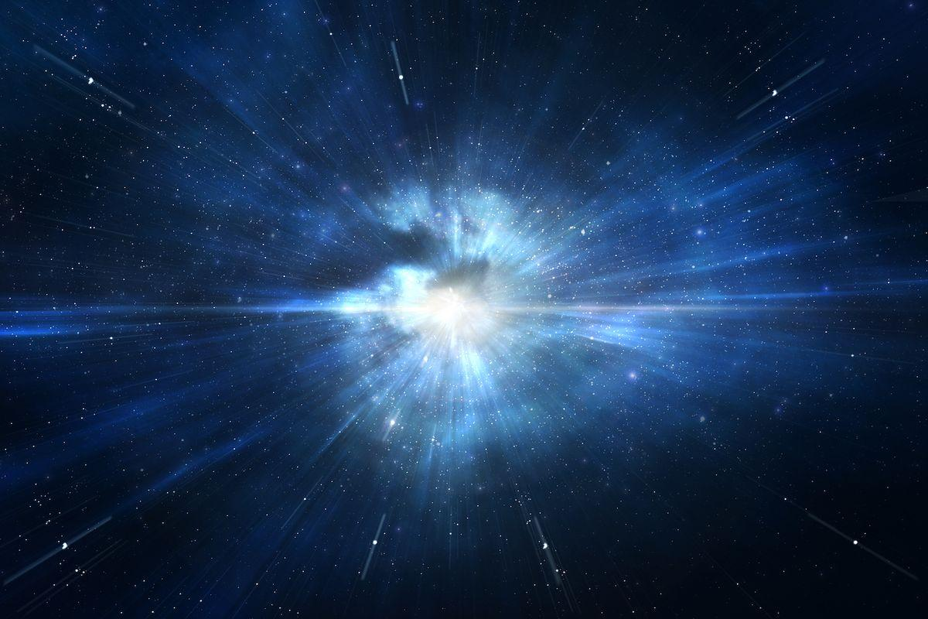


Tritium Burning:
Big Bang Nucleosynthesis
Ani Aprahamian
University of Notre Dame
October 29, 2025
Neutron Physics & Radiation Materials Conference
Yerevan, Armenia
Oct. 27-30, 2025
Notes:
Good Morning…it is a pleasure to be here at the Neutron Physics & Radiation Materials Conference in Yerevan…sponsored by the Applications division of AANL and the
Frank neutron laboratory…
I was impressed to hear about the possibilities at the Frank neutron Laboratory…My nuclear physics career has spanned the uses of neutrons from reactors to accelerators and synchrotons.
We have now created a neutron beam at the University of Notre Dame Nuclear Science Laboratory…for doing n,n’ reactions to measure nuclear lifetimes…
Today, My talk is about the creation of neutrons in the universe and the evolution of neutrons as tritium and other light nuclear storage for release later to explain some of the
Amazing elemental abundances in the Universe…I could call my talk..the creation of neutrons and the role they play in the cosmos.
Tritium is short lived…and traditionally not considered to be significant in nucleosynthesis…and we think it can be significant…for solving some outstanding open questions in the cosmos…
Such as the observed lower abundances of Li…synthesis beyond the A=5 and 8 gaps…and in the re-assembly of isotopes in core collapse/star merger scenarios.

Slide 2
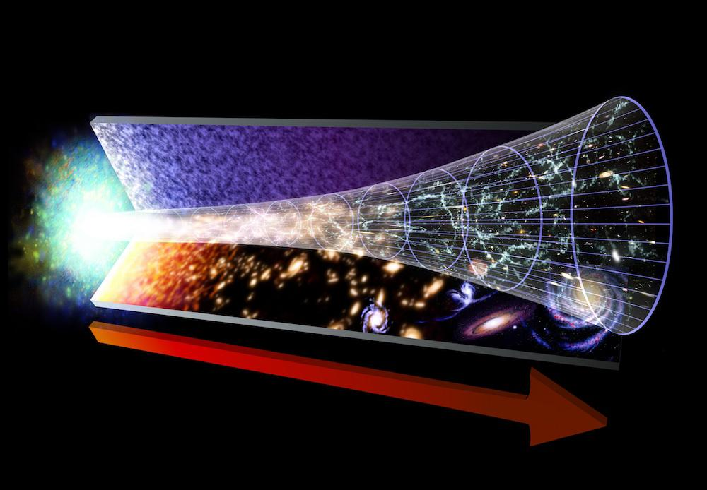
Neutrons and protons formed 1s after the big bang
Notes:
Expansion and cooling….

Slide 3
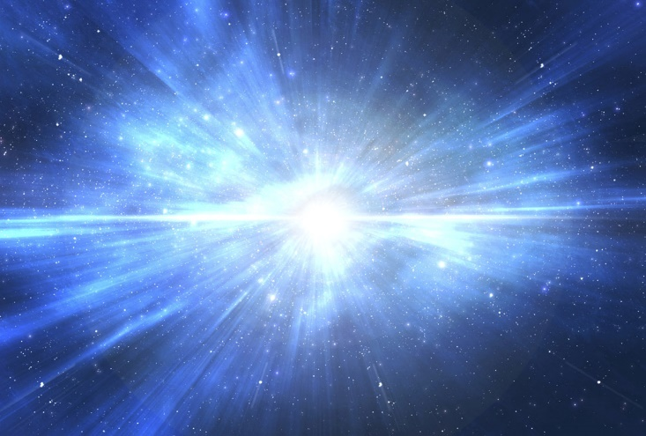
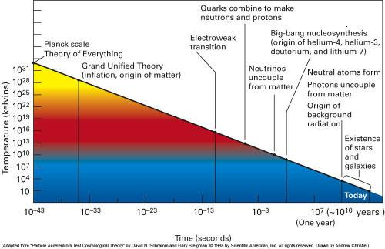
The Expansion of the Universe and the decoupling of Interactions
Planck time
Decoupling events correspond to periods in the development of the universe when different types of particles fall out of thermal equilibrium with each other. This occurs as a result of the expansion of the universe, as their interaction rates decrease (and mean free paths increase) up to this critical point.
Inflation corresponds to the decoupling of the gravity
introducing first inhomogeneities into the universe
Neutrino (lepton) decoupling
Inflation
Quark confinement
deuterium
freeze-out
Photon decoupling
Quark-gluon plasma
hadron
stars
n-p
quark epoch ended when the universe was about 10⁻⁶ seconds
decoupling of weak interaction forms p, n dominated abundance distribution, which is converted to α.

Slide 4
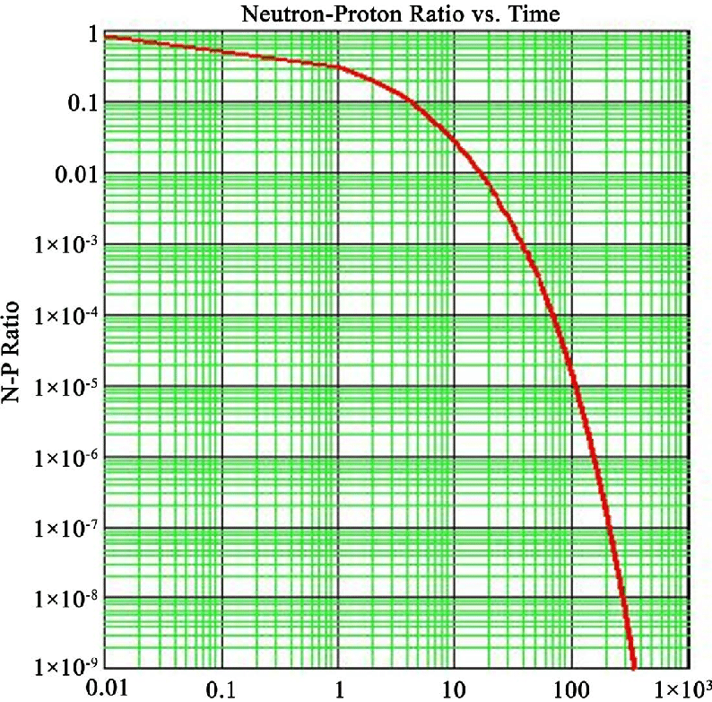
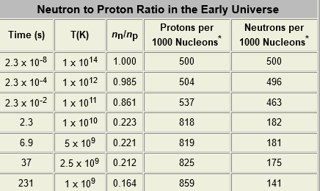
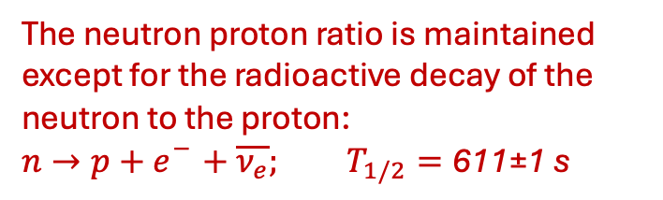
Neutron-proton ratio versus time
Time in seconds
The actual half-life is a bit of a mystery. One method measures it as 615.3 seconds, plus or minus 2.2 seconds. Another method measures it as 608.9 seconds, plus or minus 0.8 second.

Slide 5
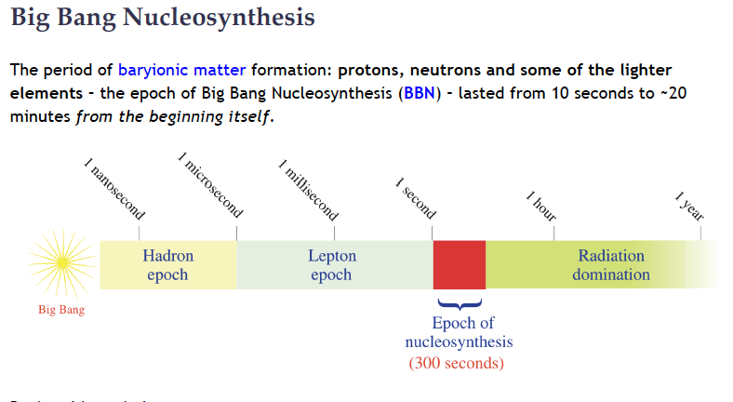
n , p
H, ²H, ³H, ³He, ⁴He, ⁶Li, ⁷Li, and ⁷Be
Notes:
Tritium is a primordial isotope…has a half life of 12.323 yrs…and generally not considered to have a significant role… in long lived stellar burning scenarios….
but there are some short-lived nucleosynthesis scenarios in which Tritium formation and tritium induced reactions can be critical…although not yet explored

Slide 6
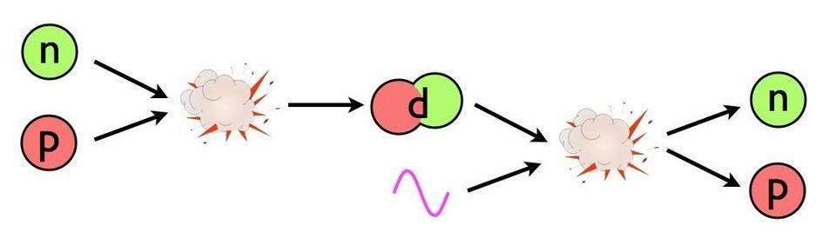
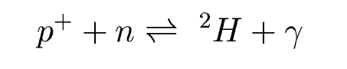
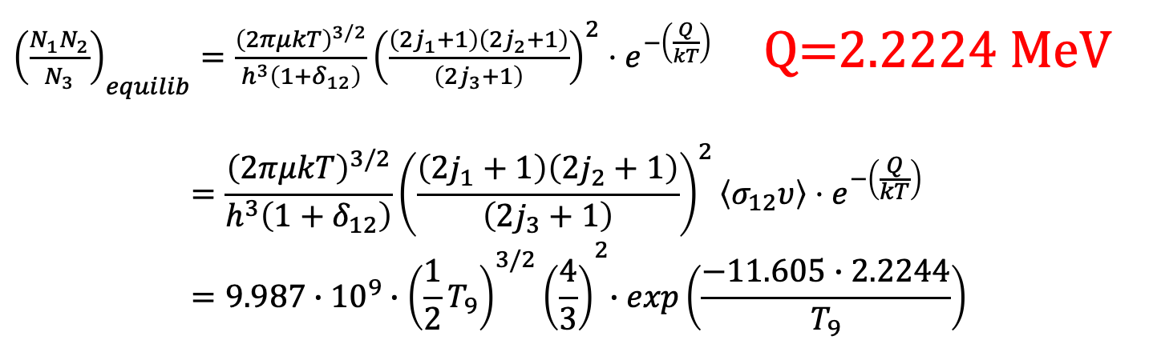
The Onset of Nucleosynthesis in the Third Minute
The deuteron can be considered as excited state
of the n+p two particle system and initially there is a balance between proton and neutron fusion and photodisintegration!
${\left(\frac{N_{1}N_{2}}{N_{3}}\right)}_{equilib}=\frac{{\left(2πμkT\right)}^{3/2}}{h^{3}\left(1+δ_{12}\right)}{\left(\frac{\left(2j_{1}+1\right)\left(2j_{2}+1\right)}{\left(2j_{3}+1\right)}\right)}^{2}⋅e^{−\left(\frac{Q}{kT}\right)}$ Q=2.2224 MeV
$$=\frac{{\left(2πμkT\right)}^{3/2}}{h^{3}\left(1+δ_{12}\right)}{\left(\frac{\left(2j_{1}+1\right)\left(2j_{2}+1\right)}{\left(2j_{3}+1\right)}\right)}^{2}\left\langle σ_{12}υ\right\rangle ⋅e^{−\left(\frac{Q}{kT}\right)}=9.987∙{10}^{9}{∙{\left(\frac{1}{2}T_{9}\right)}^{3/2}\left(\frac{4}{3}\right)}^{2}∙exp\left(\frac{−11.605∙2.2244}{T_{9}}\right)$$
Notes:
Temperature drops and photon energy drops below the Q value….so…the photodisintegration is hindered….

Slide 7
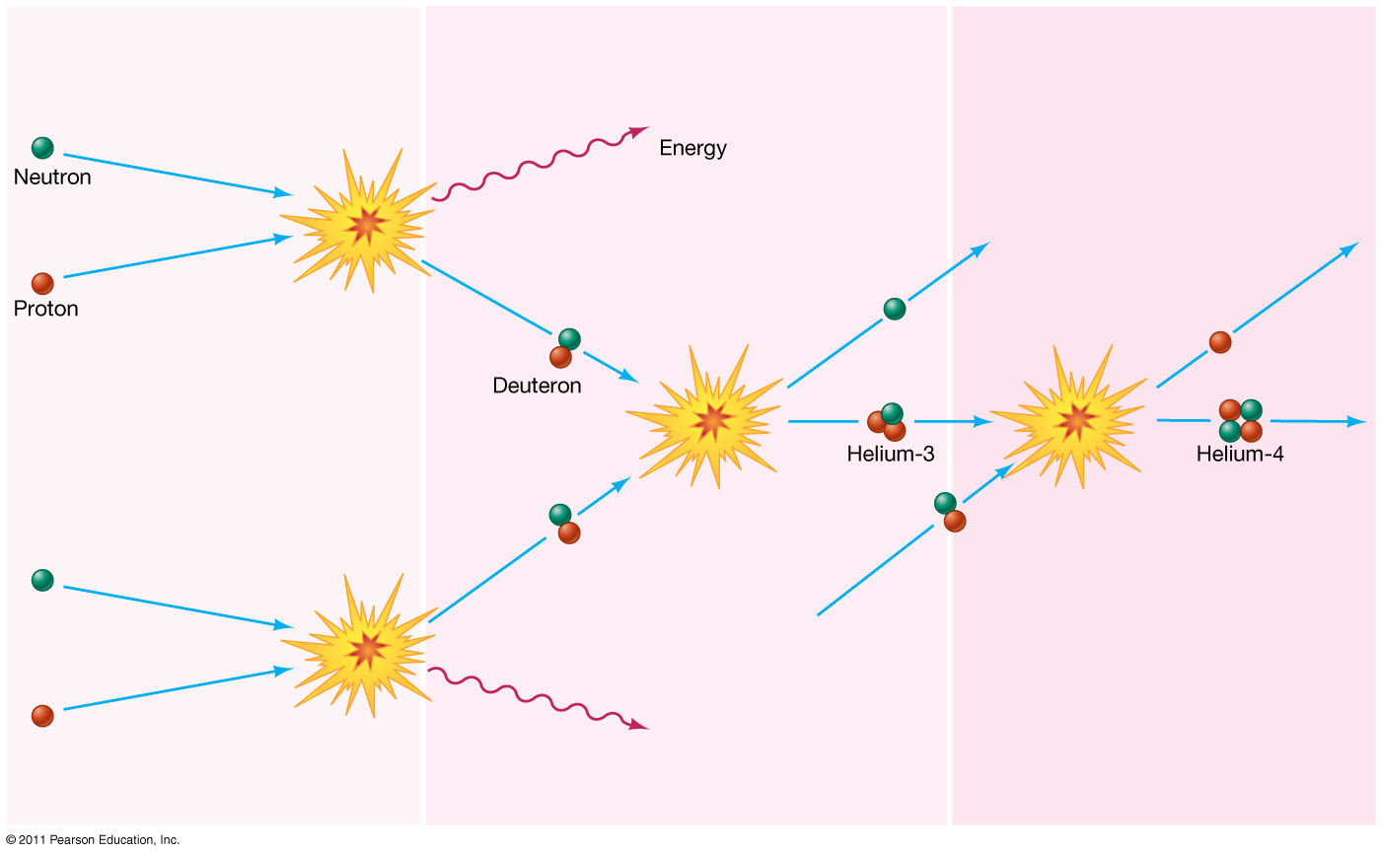
Notes:
Deuteron increases….

Slide 8
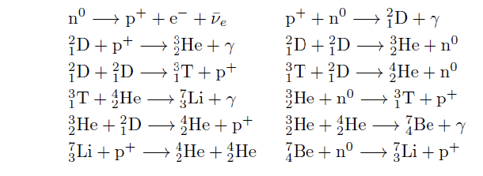
Primordial Isotopes + n + γ+ p
Tritium as a storage of neutrons

Slide 9
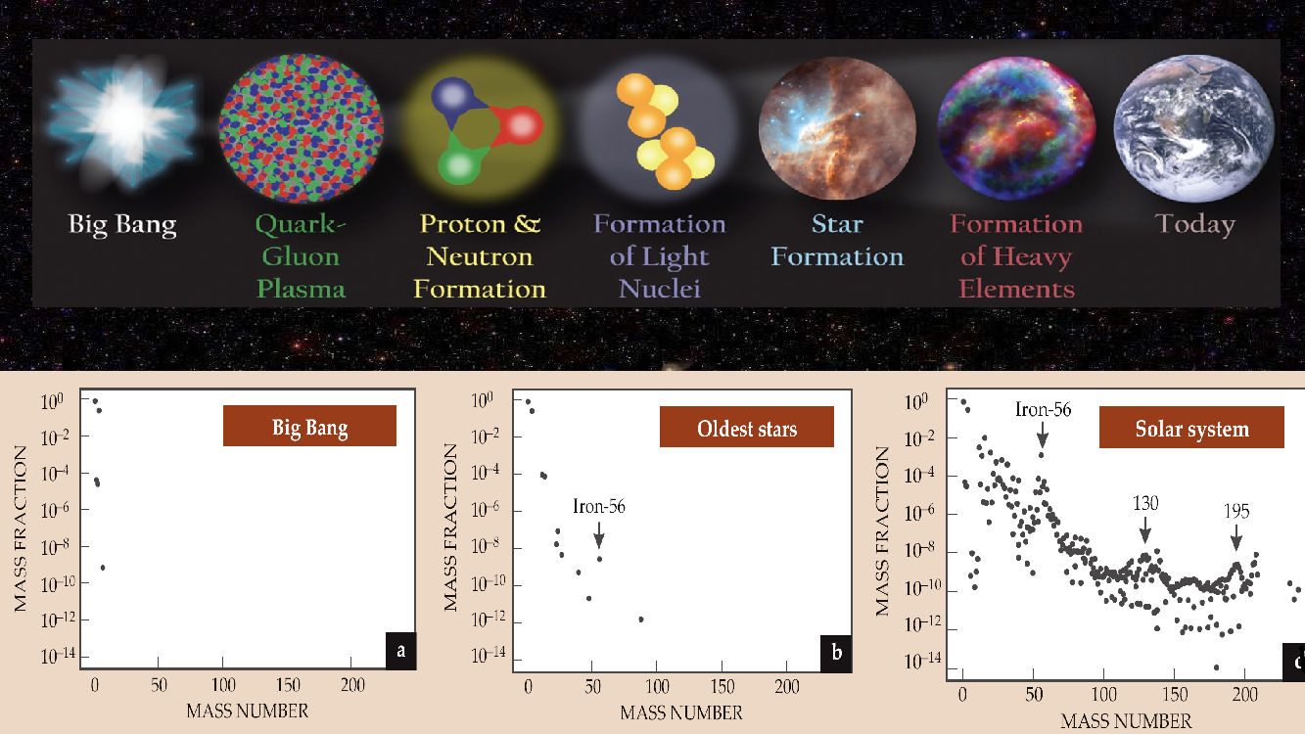
Wiescher & Schatz
Primordial elements
H, d, He, Li, Be
Notes:
Approximately three minutes after the Big Bang,
the abundances of the primordial elements in the universe include protons, deuterons, ³He, ⁴He, and trace amounts of lithium and beryllium.
Neutrons…needed….what we think is that neutrons play a role in the production and use of the primordial elements as well as the lighter…life elements, C, N, O
What we are proposing is a role for neutrons in big bang nucleosynthesis

Slide 10
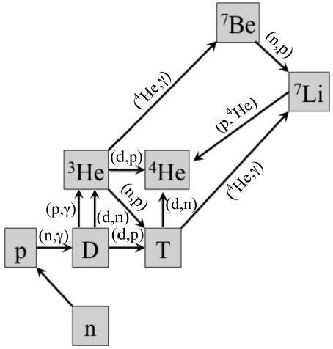
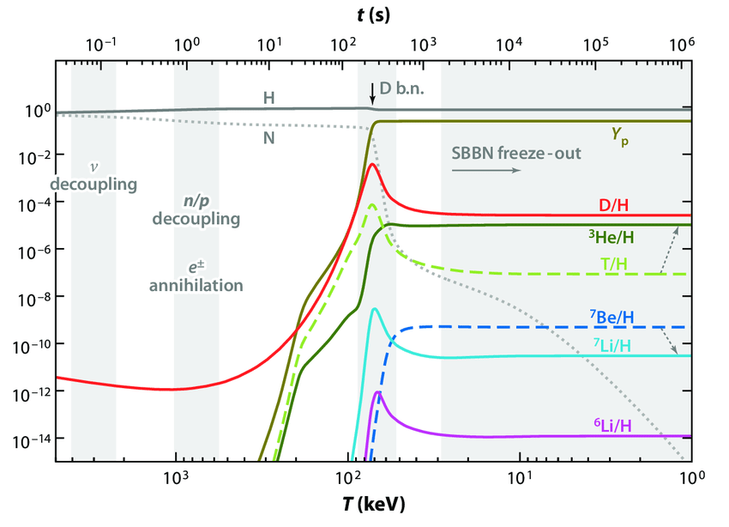
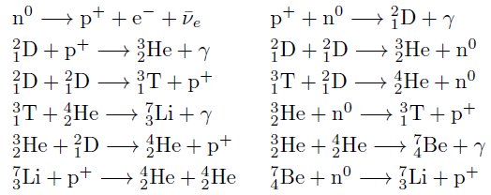
reactions after deuterium formation
Onset of nucleosynthesis with the freeze out of deuterium photo-dissociation
Time (s)
Notes:
Tritium formation

Slide 11
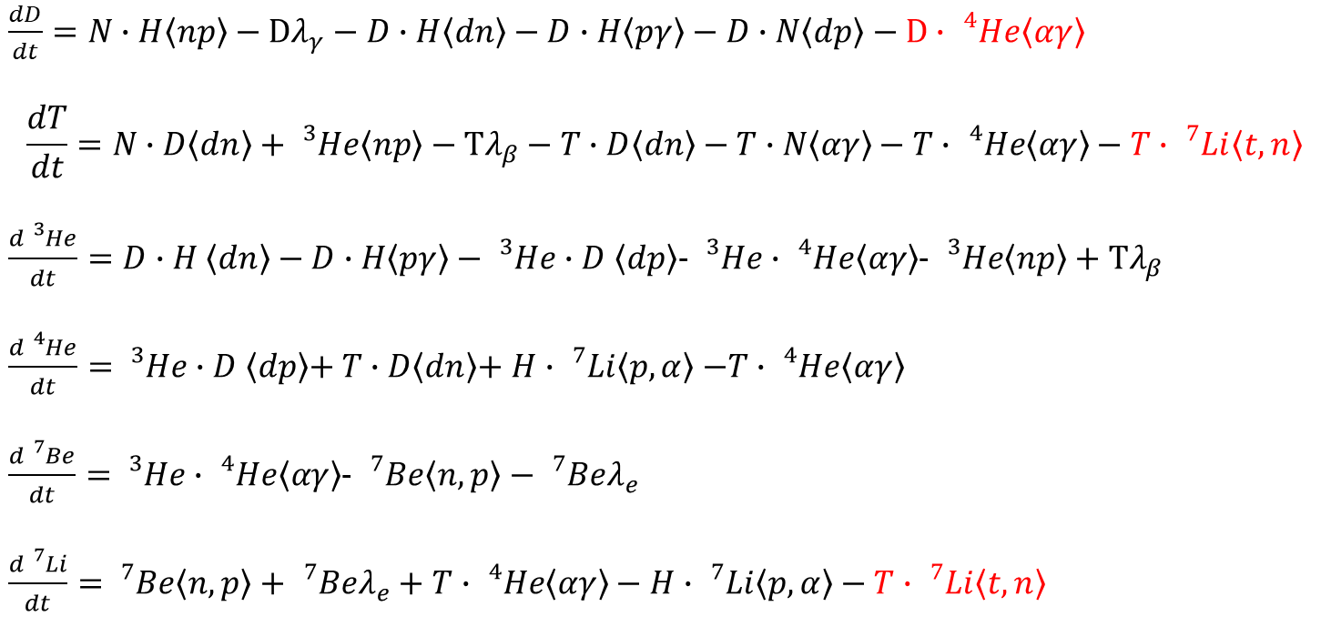
Reaction network for simulating the synthesis
Set of differential equations deriving the change in abundance with time as a function of time dependent reaction rates!
$\frac{dD}{dt}=N∙H\left\langle np\right\rangle −Dλ_{γ}−D∙H\left\langle dn\right\rangle −D∙H\left\langle pγ\right\rangle −D∙N\left\langle dp\right\rangle −D∙$ ${}_{}^{4}{He\left\langle αγ\right\rangle }$
$$\frac{dT}{dt}=N∙D\left\langle dn\right\rangle +{}_{}^{3}{He\left\langle np\right\rangle }−Tλ_{β}−T∙D\left\langle dn\right\rangle −T∙N\left\langle αγ\right\rangle −T∙{}_{}^{4}{He\left\langle αγ\right\rangle }−T∙{}_{}^{7}{Li\left\langle t,n\right\rangle }$$
$\frac{d{}_{}^{3}{He}}{dt}=D∙H$ $\left\langle dn\right\rangle −D∙H\left\langle pγ\right\rangle −{}_{}^{3}{He∙D}$ $\left\langle dp\right\rangle$- ${}_{}^{3}{He∙{}_{}^{4}{He\left\langle αγ\right\rangle }}$- ${}_{}^{3}{He\left\langle np\right\rangle +Tλ_{β}}$
$\frac{d{}_{}^{4}{He}}{dt}=$ ${}_{}^{3}{He∙D}$ $\left\langle dp\right\rangle$+ $T∙D\left\langle dn\right\rangle$+ $H∙{}_{}^{7}{Li\left\langle p,α\right\rangle }$ $−T∙{}_{}^{4}{He\left\langle αγ\right\rangle }$
$\frac{d{}_{}^{7}{Be}}{dt}=$ ${}_{}^{3}{He∙{}_{}^{4}{He\left\langle αγ\right\rangle }}$- ${}_{}^{7}{Be\left\langle n,p\right\rangle −}$ ${}_{}^{7}{Beλ_{e}}$
$\frac{d{}_{}^{7}{Li}}{dt}=$ ${}_{}^{7}{Be\left\langle n,p\right\rangle +}$ ${}_{}^{7}{Beλ_{e}}+$ $T∙{}_{}^{4}{He\left\langle αγ\right\rangle }−H∙{}_{}^{7}{Li\left\langle p,α\right\rangle }−T∙{}_{}^{7}{Li\left\langle t,n\right\rangle }$
Tritium ?

Slide 12
Fundamental Questions to be addressed
Cosmological Li problem: What happened to the Li?
The origin of C-N-O elements
Mass A=5 and A=8 gaps (Big Bang Nucleosynthesis)
Extreme conditions- reassembly after core collapse
or neutron star merger scenarios
BBN?
Notes:
Some of the important short-lived scenarios
CNO in very old stars….did BBN contribute to all that? Specifically Tritium induced reactions providing an alternate path

Slide 13
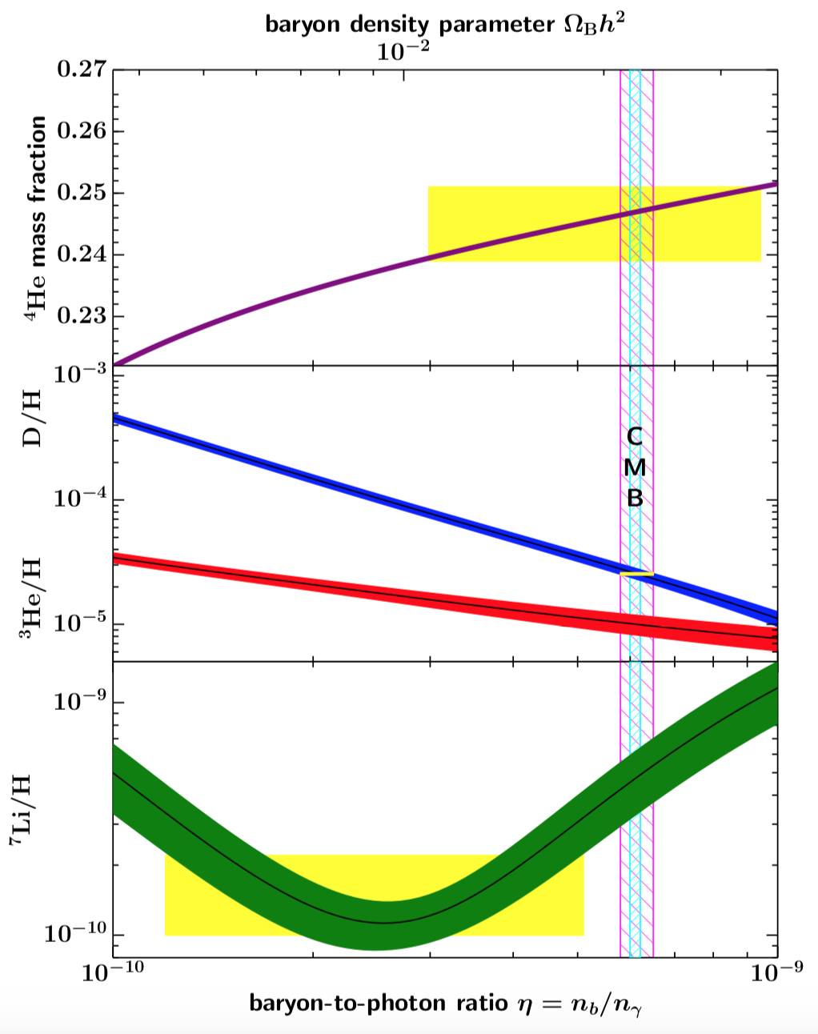
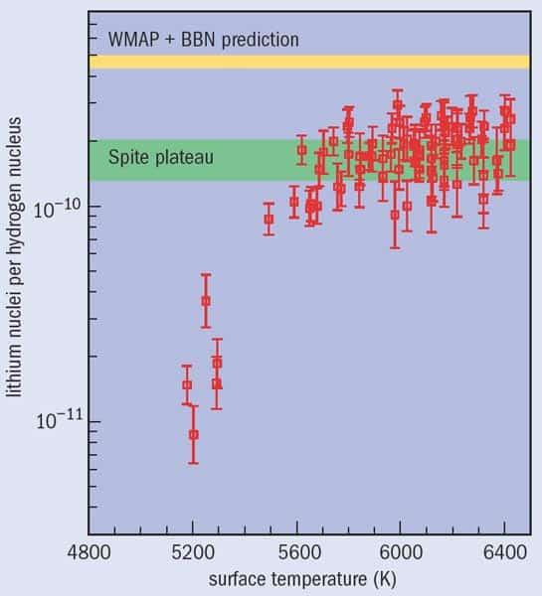
The cosmological ⁷Li problem: Where did the Li go?
Cosmic baryon densities from Cosmic Microwave Background
Spite Plateau

Slide 14
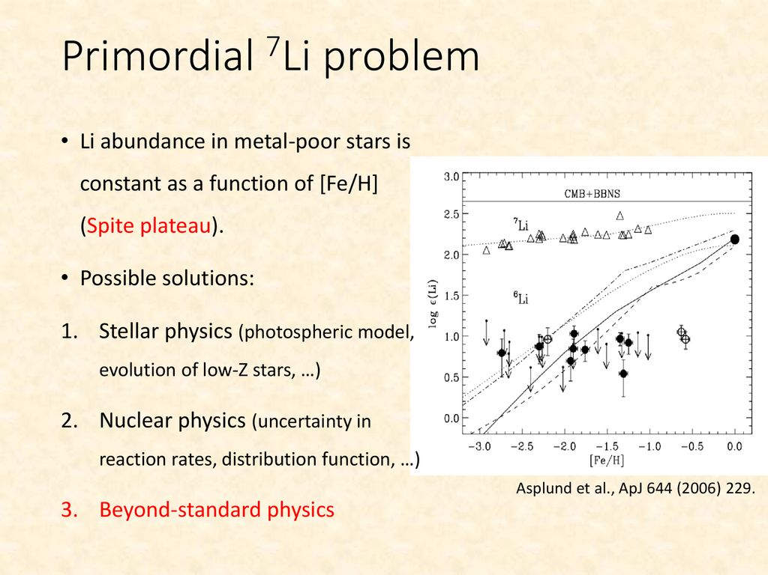

The cosmological ⁷Li problem
Ω_{b}h² = 0.0224 ± 0.0001
It is substantially lower than predicted by SBBM!
$η=$6.14 x 10⁻¹⁰
Notes:
We propose tritium ….as a way to jump over the gaps…to make CN….reduce the Li availability

Slide 15
Bridging the Mass A=5 and A=8 Mass Gap
There are no stable nuclei with mass A=5 and mass A=8 in the universe!
The formation of heavier nuclei may be facilitated through neutron induced reactions feeding tritium with subsequent tritium capture.
This might be facilitated through neutron enriched inhomogeneities in the expanding universe.
⁸B
⁹B
¹⁰B
⁷Be
⁸Be
⁹Be
⁵Li
⁶Li
⁷Li
⁸Li
²He
³He
⁴He
⁵He
A=8 mass gap
¹H
²H
³H
A=5 mass gap
²n
Can we bridge the mass gap with tritium and solve the Li problem?
¹n

Slide 16
Tritium reactions to explain the observed Li deficit
The neglect of these tritium reactions may explain why the observed ⁷Li abundance is three-four times lower than predicted!
Subsequent ⁹Be(α,n)¹²C may generate neutrons and ¹²C.
⁹Be
¹⁰Be
(t,n)
(t,γ)
³H(t,2n) fusion and ³H(³He,pn) fusion require further studies at low energies.
The ³H(α,γ)⁷Li fusion studies show pronounced discrepancies.
Given the high abundances of tritium in the early Big Bang environment also the strength of the subsequent ⁷Li(t,γ)¹⁰Be and ⁷Li(t,n)⁹Be reactions need to be investigated as possible solution of Lithium problem.
Notes:
Depletion of Li

Slide 17
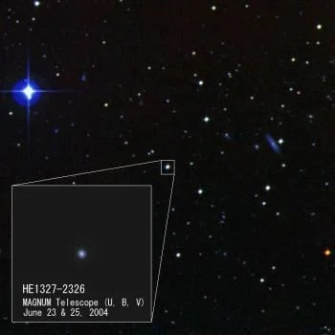
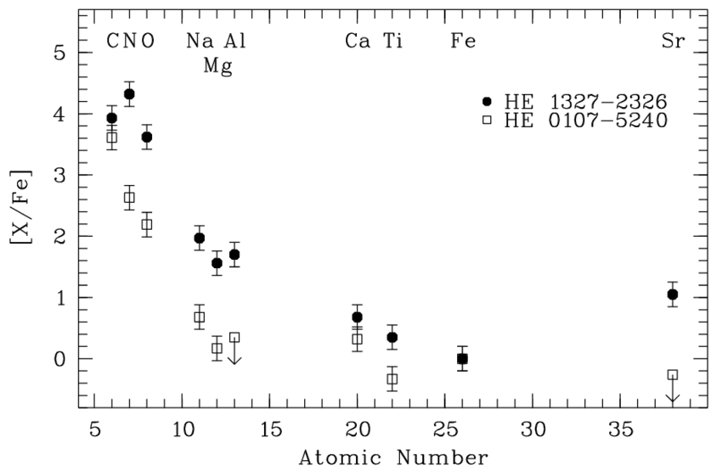
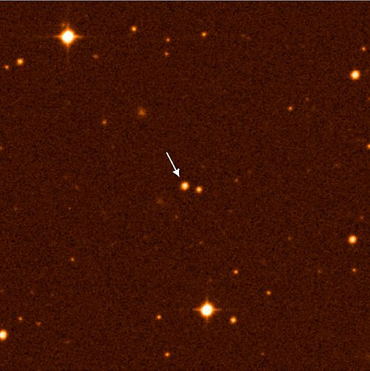
Element Distributions in very old Stars
SI.a
He 1327-2326
He 0107-5240
How are the CNO elements formed before CNO cycle?
First stars on primordial matter?
Big Bang nucleosynthesis…tritium?
Notes:
Tritium would bridge the mass gaps at A=5 and A=8 and solve the Li problem

Slide 18
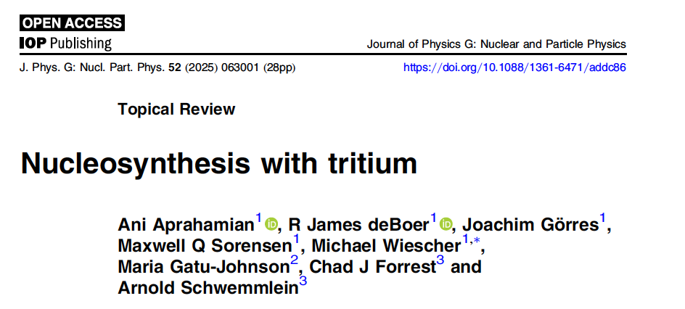

Slide 19
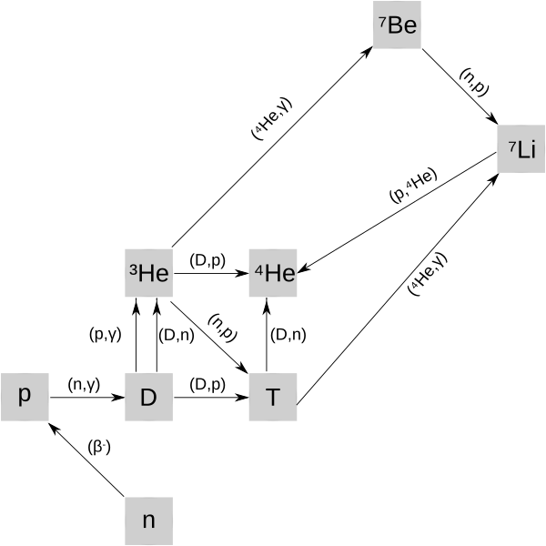
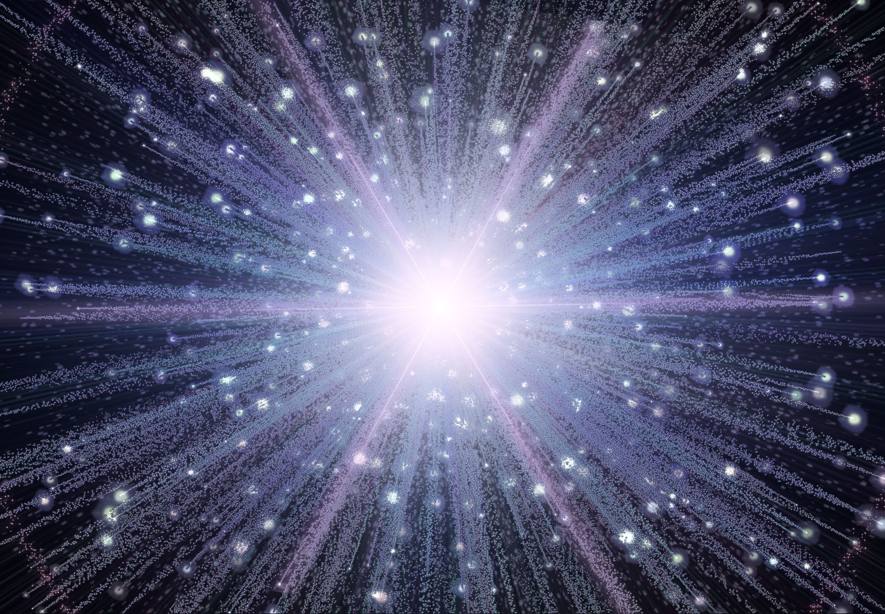
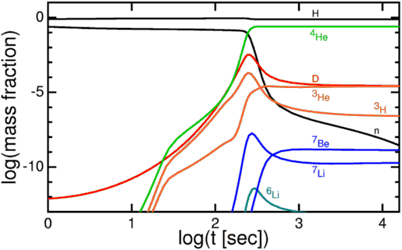
Formation of tritium as neutron storage
Big Bang nucleosynthesis building heavier elements within a 10 m timescale
¹H(n,γ) ²H(n,γ)/(d,p)³H(α,γ)⁷Li
³H serves as intermediary storage for neutrons,
facilitating the bridge of the mass 5 and mass 8
gap feeding the heavier isotopes while generating
a high neutron flux if the reaction rates are competitive with inverse ⁷Li(p,α)⁴He process
⁷Li(α,γ)¹¹B(α,n)¹⁴N or ¹¹B(t,n)¹³C(t,n)¹⁵N
⁷Li(t,n)⁹Be(α,n)¹²C(t,n)¹⁴N or ⁹Be(t,n)¹¹B(α,n)¹⁴N or ¹¹B(t,n)¹³C

Slide 20
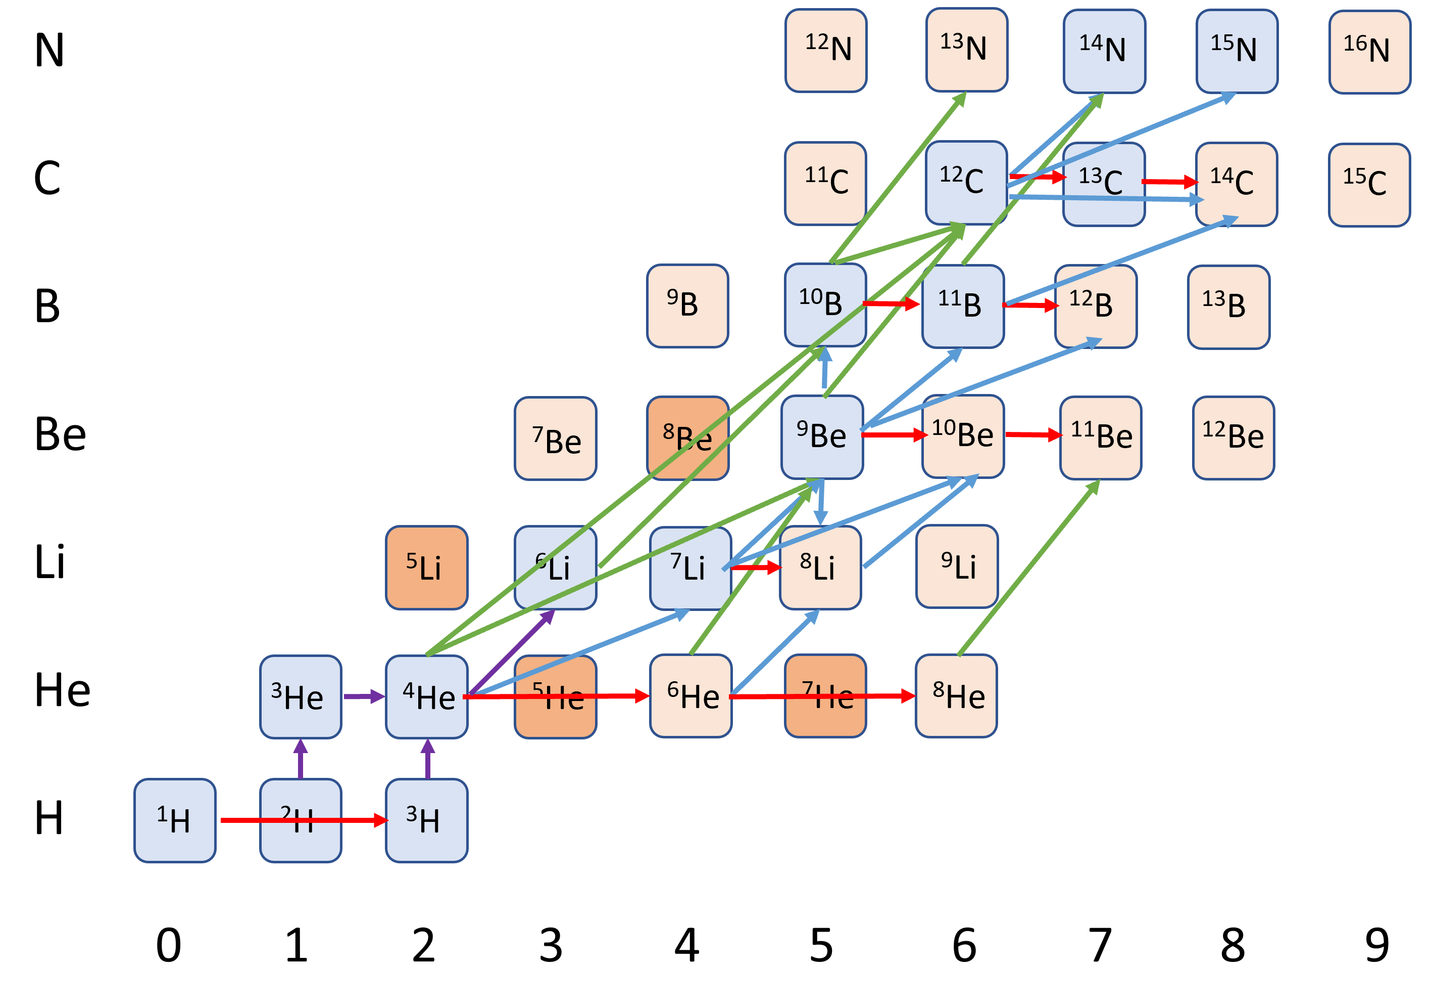
Expanded Big Bang scenario based on tritium
Adopting increased tritium induced reaction rates leads to an intense secondary neutron release in a complex network of nuclear
reactions!
We consider:
³H(t,γ)⁶He(t,n)⁸Li(α,n) (triple-triton rx.)
⁷Li(t,n)⁹Be(α,n)
⁹Be(t,n)¹¹B(α,n)
¹⁰B(t,n)¹²C(t,n)¹⁴N
Bridging the
mass A=5 and 8 gap
¹¹B(t,n)¹³C(α,n)
⁴He(t,γ)⁷Li(t,n)⁹Be(t,n)¹¹B(t,n)¹³C(t,n)¹⁵N
Notes:
We calculated these reaction rates based on data from USA and USSR in the 1970’s but now we want to use a new approach…Plasma

Slide 21
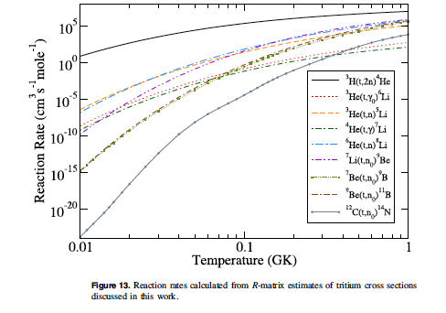
Predicted reaction rates
Should be measured!

Slide 22
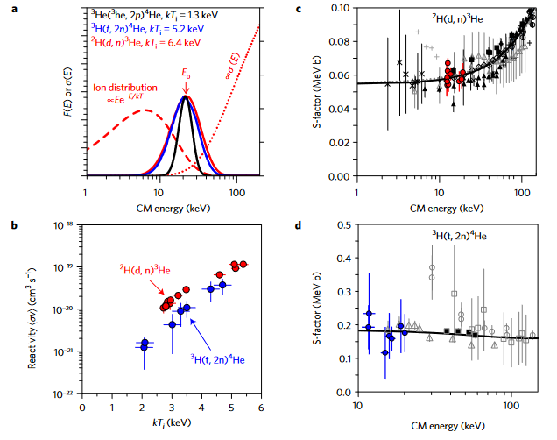
Have they been measured with accelerators? Comparison
Plot of ²H(d,n)³He cross-section (dotted red curve), center-of-mass energy distribution at kT_{i} = 6.4 keV (dashed red curve), and resultant reactant energy distribution (solid red curve). Also shown are the ³H(t,2n)⁴He (solid blue curve) and ³He(³he,²p)4He (solid black curve) reactant distributions with the same E0.
Dan Casey et al. Thermonuclear reactions probed at stellar-core conditions with laser-based inertial-confinement fusion Nature 2017 DOI: 10.1038/NPHYS422

Slide 23
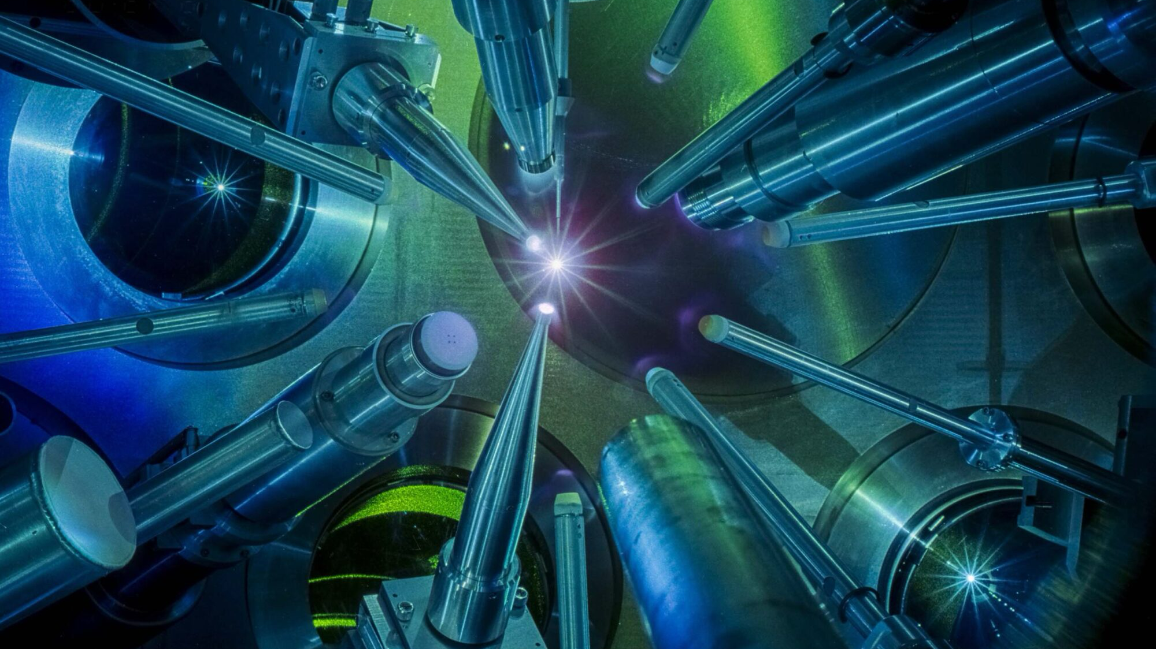
Omega Laser facility at the University of Rochester Laser Energetics Laboratory

Slide 24
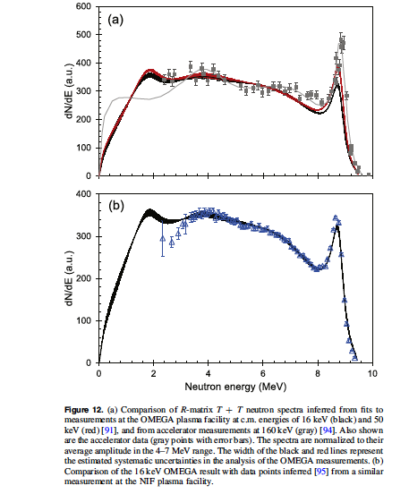
RED: 50 keV c.m. energy
Black: 16 keV c.m. energy
Gray: 160 keV
Black: 16 keV c.m. Omega
Blue: 16 keV c.m. NIF

Slide 25
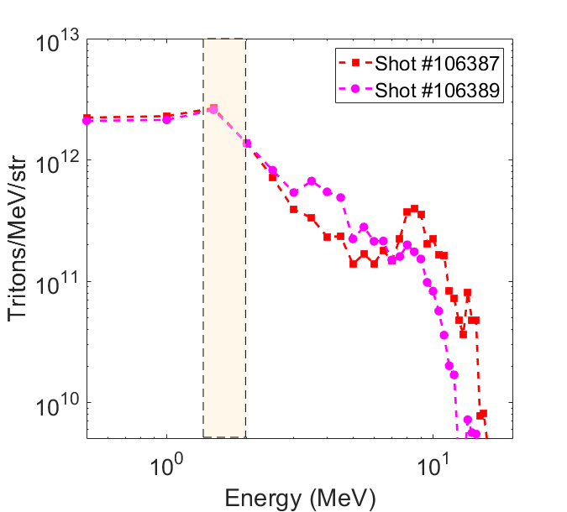
Future Experiments with tritium
A(α,p)B tritium stripping experiments to populate tritium cluster states at tritium threshold. (Local exploration effort via A(α,p) or A(⁷Li,α) at the ND- NSL Enge)
B(t,t’) inelastic scattering experiments at FSU’s John Fox Laboratory
Purchase of a tritium target through Air Force Academy grant for inverse kinematic experiments e.g. ³H(⁷Li,n), ³H(¹⁰B,n), ³H(¹²C,n) (Mike Febbraro-ND NSL)
⁹Be(n,t) and ¹¹B(n,t) experiments at LANSCE/LANL or n_ToF/CERN facilities (LANL)
High flux tritium beam production at
NIF(LLNL), OMEGA and OPAL (U of Rochester) plasma facilities
Omega
Notes:
Experiments to measure….there are no tritium faciltiies available anymore….

Slide 26
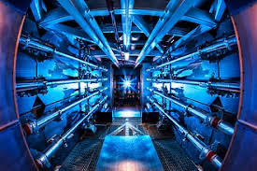
National Ignition Facility: Lawrence Livermore National Laboratory

Slide 27

The NSF OPAL project proposes to build the world’s most powerful laser
enabling scientists to investigate the mysteries of the universe.
2-25 Petawatt lasers

Slide 28
The National Science Foundation (NSF) has awarded a Mid-Scale Research Infrastructure (RI-1) Design Award for NSF-OPAL, which will be the world’s most powerful laser system once built. The current ~18 million in funding funding will support the design of two 25-petawatt lasers utilizing optical parametric chirped-pulse amplification, along with associated experimental and diagnostic systems.
Four frontier science working groups have been formed that will help guide the scientific mission of NSF OPAL, these
working groups and examples of flagship experiments include:

Slide 29
* Particle Acceleration and Advanced Light Sources Through dephasingless Laser Wakefield Acceleration, hundreds of GeV electron beams will be produced from NSF OPAL
* High-Field Physics and Quantum Electrodynamics At sufficiently high intensities, the very vacuum itself may behave as a nonlinear optic
* Laboratory Astrophysics and Planetary Physics NSF OPAL will create matter at the extreme conditions found in our universe, enabling us to study it in the lab
* Laser-Driven Nuclear Physics Nuclear reactions using laser driven triton beams enable the exploration of new fusion modalities

Slide 30




NSF OPAL
This letter advocates for the funding of a future NSF OPAL user facility, highlighting its importance to the science community and U.S. scientific leadership. Please consider signing and forwarding this link to others interested in supporting NSF OPAL.
https://nsf-opal.rochester.edu/letter-of-support

Slide 31


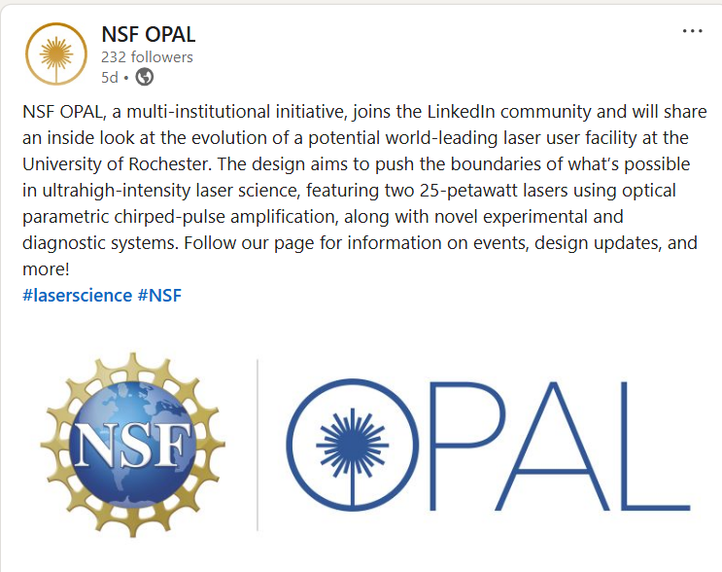

Follow on LinkedIn to stay up-to-date on all things NSF OPAL
https://linkedin.com/ company/nsf-opal
NSF OPAL has joined the LinkedIn community and will be sharing an inside look at events, design updates, and more!

Slide 32
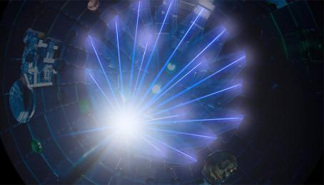
Conclusion
The Cosmological Li problem may be solved with the measurements of tritium induced nuclear reaction cross-sections.
Also, (alpha,n) reactions provide the neutron sources for r-process in much lighter nuclei.
Other possibilities exist…
Thank you for your attention!

Slide 33
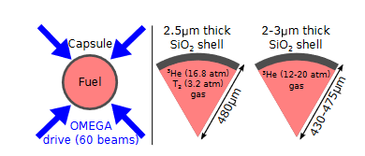
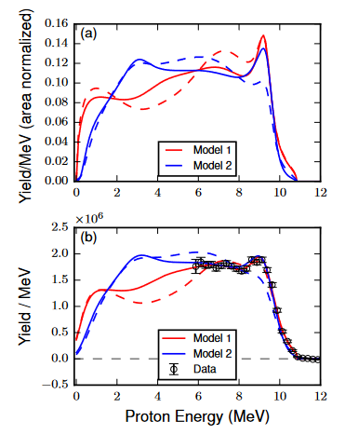
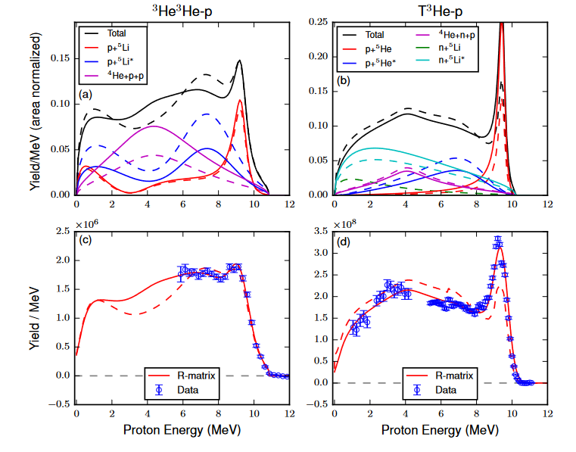
Plasma shots
Spectral Analysis integrating over the 1 pico-second shot period and energy distribution
T+T simulations adapted to ³He+³He data

Slide 34
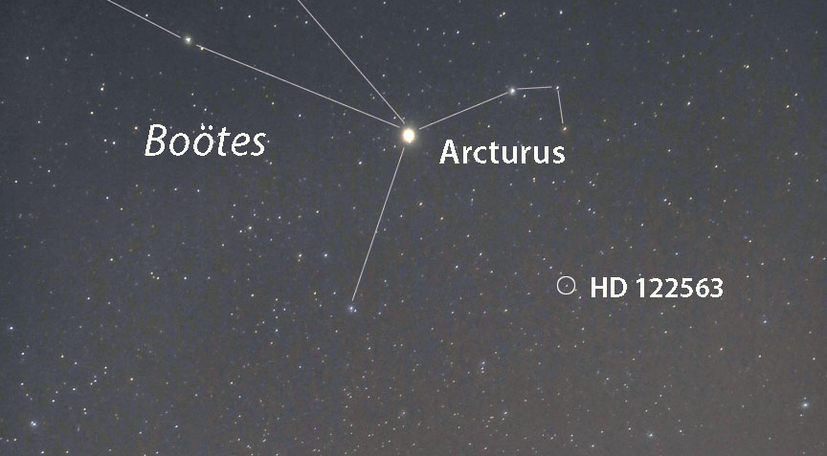
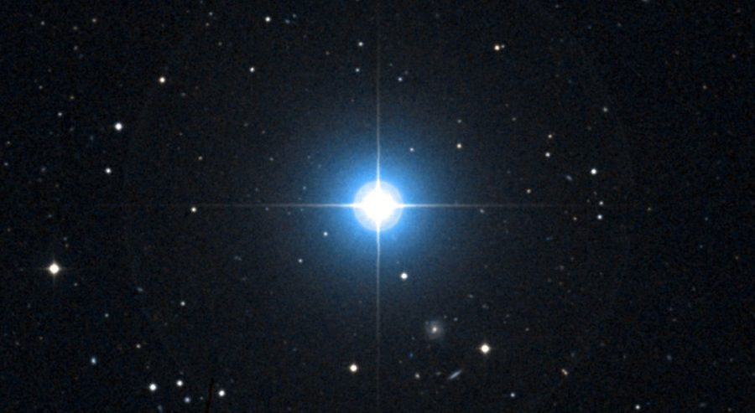
The Spite Plateau and the ⁷Li problem
Observations of metal-poor halo stars show a relatively constant lithium abundance, known as the "Spite plateau," across a range of stellar temperatures and metallicities. The Spite Plateau is the basis for the low assessment of primordial lithium, which may be explained by lithium diffusion issues in the outer atmosphere of these frequently very convective stars!
Observations of metal-poor halo stars
HD 122563 in Boötes is the brightest, oldest visible star visible in the sky. Formed nearly 13 billion years ago, it's a member of the Milky Way's halo.

Slide 35
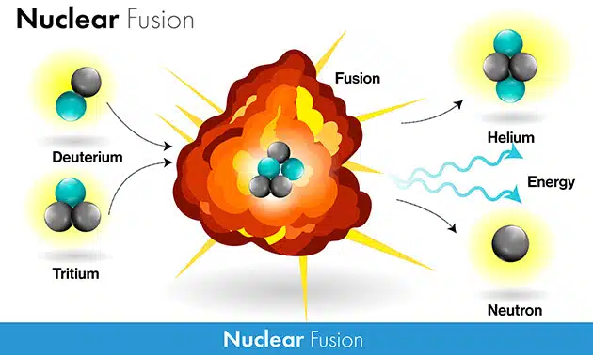
Fusion Physics
Notes:
Teller realized that d,t is much stronger than d,d
Kopinski…

Slide 36
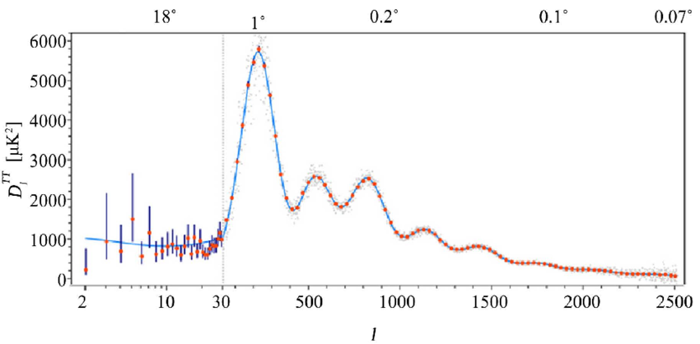
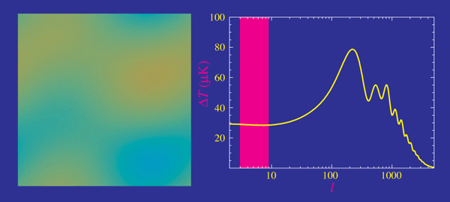
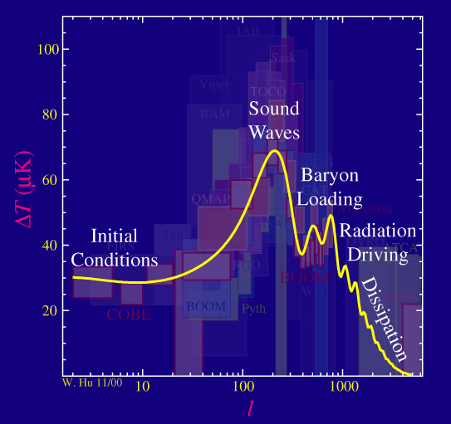
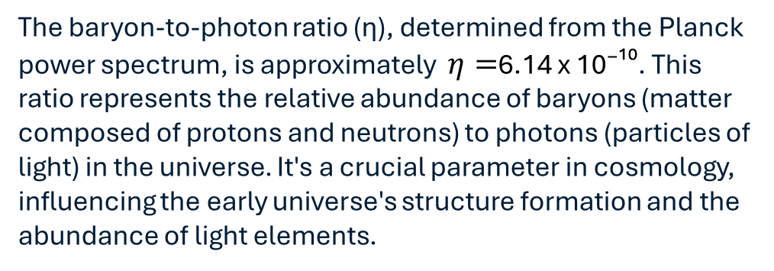
Information from WMAP and Planck
The angular power spectrum is calculated, which describes the distribution of power across different angular scales (represented by the multipole moment, l). The CMB power spectrum exhibits characteristic peaks and troughs, known as baryon acoustic oscillations (BAOs). These oscillations are essentially fossilized sound waves in the early universe, frozen in place at the time of recombination when the universe cooled sufficiently for atoms to form.
The baryon-to-photon ratio (η), determined from the Planck power spectrum, is approximately $η=$6.14 x 10⁻¹⁰. This ratio represents the relative abundance of baryons (matter composed of protons and neutrons) to photons (particles of light) in the universe. It's a crucial parameter in cosmology, influencing the early universe's structure formation and the abundance of light elements.
The baryon-to-photon ratio is directly related to the baryon density parameter, Ω_{b}h², which is a measure of how much of the universe's energy density is made up of baryons. The Planck 2018 results provide a value of Ω_{b}h² = 0.0224 ± 0.0001
The temperature power spectrum separates the intensity of hot and cold spots in the temperature map of different angular scales, giving information about the origins of the BAOs.

Slide 37
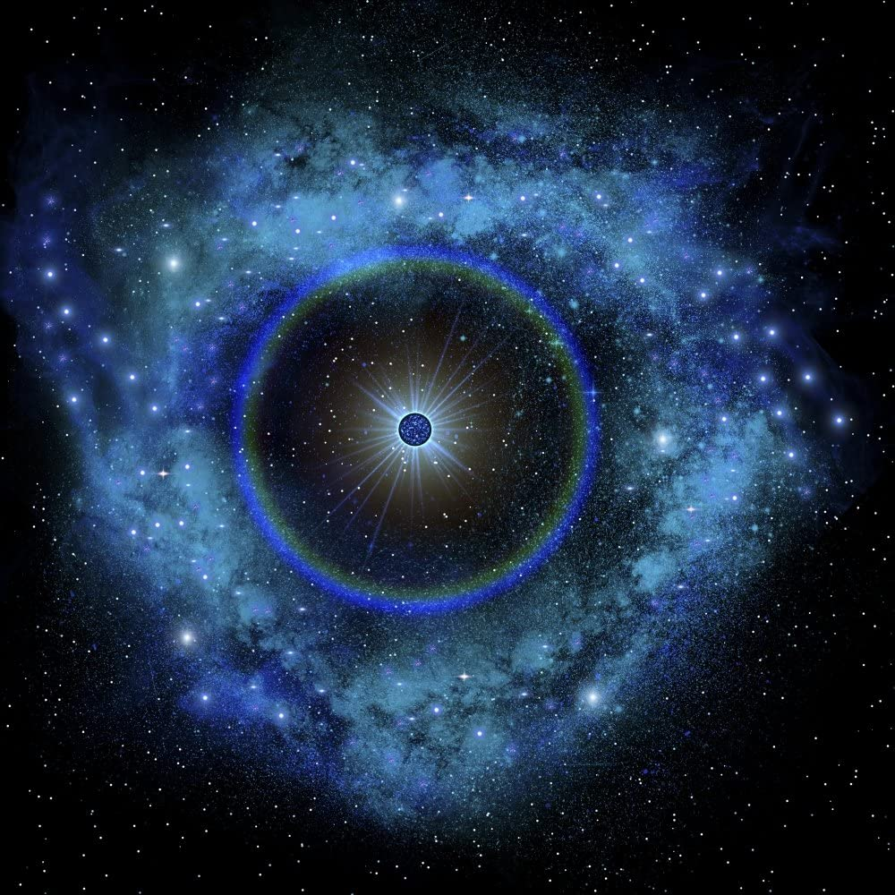
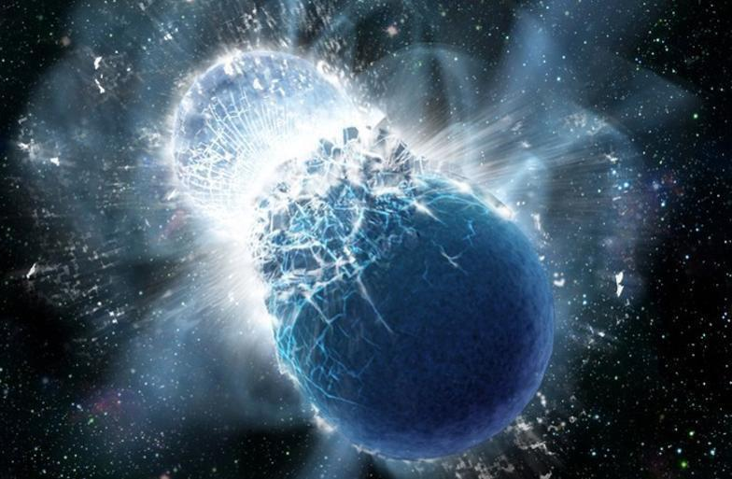
S
Is this important beyond Big Bang?
Dissociation of elements at high temperature and density conditions?
Neutrino driven wind
Merging neutron stars

Slide 38
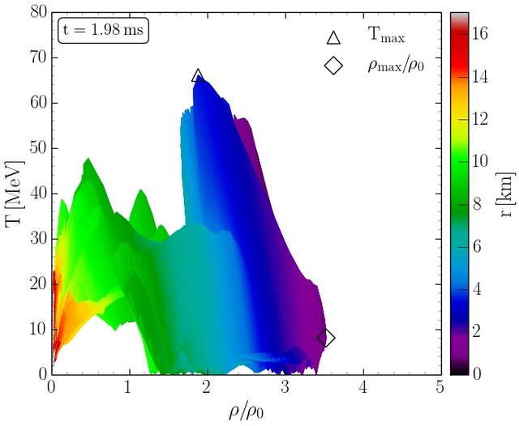


Rapidly expanding high density matter
Core Collapse Supernova or neutron star merger conditions rebuilding heavier elements in the neutrino driven expansion phase in statistical equilibrium. The onset is delayed by A=5 and A=8 mass gap, which needs to be bridged within milliseconds
Conversion from p, n, α to ³He, ⁷Li, ⁹Be, ¹⁰B, ¹⁴N with delayed release of neutrons to trigger light r-process!
Notes:
Convective environments of core collapse supernovae

